Slide 1

Inclusive Career Paths for Differently Abled People
Theme – SDG Goal 8: Decent Work and Economic Growth
Category – Software
Group No – 8
Group Members – Yash Sawant Harsh Raulgaonkar
Parth Rane Sohan Vernekar
Guide – Prof. Yogeshwari Hardas

Slide 2
Outline
Introduction
Literature Survey
Limitations of existing systems
Problem statement and Objectives
Proposed Methodology
Experimental Setup
Implementation
Results & Analysis
Conclusion and Future work
References

Slide 3
Introduction
Background of the Topic
Persons with disabilities often face limited access to structured career guidance systems
Traditional counseling methods do not consider functional abilities, accessibility needs, and adaptive learning requirements
Technology driven adaptive assessment systems can enable inclusive career decision support
Inclusive career platforms support equitable participation in education and employment
Importance of the Problem
High unemployment rates among persons with disabilities due to career mismatch and limited guidance
Lack of accessible recommendation platforms reduces skill utilization and economic participation
Inclusive digital career systems improve employability, independence, and social inclusion

Slide 4
Current Challenges
Absence of personalized disability-specific career assessment systems
Limited awareness of accessible career pathways and assistive technologies
Generic recommendation engines ignore functional capability constraints
Fragmented availability of skill training and disability-inclusive job databases
Motivation
Observation: Many capable individuals remain underemployed due to lack of adaptive guidance tools
Need for assisted inclusive career recommendation frameworks
Alignment with SDGs:
SDG 4: Inclusive Quality Education
SDG 8: Decent Work & Economic Growth
SDG 10: Reduced Inequalities
Objectives
Develop accessible adaptive assessment model for ability and interest mapping
Create structured inclusive career opportunity database
Provide decision support dashboards for users and support organizations
Contribute toward SDG 4, SDG 8, SDG 10 implementation through technology

Slide 5
Literature Survey
Survey of Existing Real World Solutions
Online career counseling portals provide interest-based career suggestions
Some disability focused employment platforms provide job listings for persons with disabilities
AI-based recommendation systems use interest surveys, aptitude scores, and skill profiling
Limited platforms integrate disability-specific functional ability assessment in recommendation logic
Methodologies Used
Rule-based expert systems for career matching
Machine learning classification models
Psychometric aptitude and interest assessment frameworks
Accessibility-focused employment database systems

Slide 6
Limitations Identified
Lack of personalized disability centric capability mapping
Minimal integration of adaptive assessments considering accessibility constraints
Static career suggestions without continuous adaptive learning
Limited integration of assistive technology compatibility information
Fragmented datasets across employment and disability support systems

Slide 7
Author & Year | Techniques / Methods | Dataset Used | Key Results | Limitations
Holland (1997) [1] | Interest-based career matching (RIASEC model) | Psychometric survey data | Improved career interest mapping | Does not consider disability-specific abilities
Faliagka et al. (2012) [2] | ML-based job recommendation system | Resume datasets | Automated candidate-job matching | Generic recommendation; no accessibility features
Bigham et al. (2016) [3] | Accessibility-focused computing systems | Assistive tech datasets | Improved accessibility support systems | Not focused on career pathway mapping
World Bank Disability Employment Study (2021) [4] | Employment gap statistical analysis | Global disability employment datasets | Identified employment barriers | No personalized career recommendation model
ILO Disability Inclusion Report (2022) [5] | Labor market analysis methods | Workforce inclusion datasets | Highlighted employment inequality | No technology-based adaptive guidance solutions

Slide 8
Limitation of Existing System
Existing career recommendation systems are not disability-centric and ignore functional ability variations
Lack of integrated platforms combining adaptive assessment with career pathway recommendation
Absence of personalized adaptive recommendation frameworks that update based on user performance and feedback
Limited availability of structured datasets containing disability-inclusive career requirements and accessibility constraints
Existing employment portals provide job listings but not structured career pathway guidance
Minimal use of hybrid rule-based + machine learning models for inclusive decision-support systems
Lack of assistive technology compatibility mapping within career recommendation systems

Slide 9
Problem Statement and Objective
Differently-abled individuals often lack access to inclusive career guidance systems that consider their functional abilities, accessibility needs, skills, and interests. Existing platforms rely on generic assessments and do not provide disability-specific personalized career recommendations, leading to career mismatch and limited employment opportunities. Therefore, there is a need for an adaptive, accessibility-aware career recommendation platform that delivers personalized, capability-based career pathway guidance
Objectives
Design an adaptive assessment framework to evaluate functional abilities, interests, and skills
Build a disability-inclusive career opportunity and skill requirement database
Provide accessible user interfaces and decision-support dashboards for individuals and support organizations
Promote inclusive employability and equal opportunity participation through technology-driven guidance systems

Slide 10
Proposed Solution
Develop an adaptive career guidance platform designed specifically for differently abled individuals
Collect user details, disability category, skills, and interests through an accessible interface
Conduct disability-specific adaptive assessments to evaluate functional abilities and capabilities
Generate capability profiles using weighted scoring methods
Apply rule-based eligibility filtering to remove careers not matching accessibility requirements
Use a machine learning recommendation engine to generate ranked personalized career pathways
Provide career roadmaps, required skills, and training suggestions through user dashboards
Maintain integrated databases for user profiles, assessments, career requirements, and recommendations

Slide 11
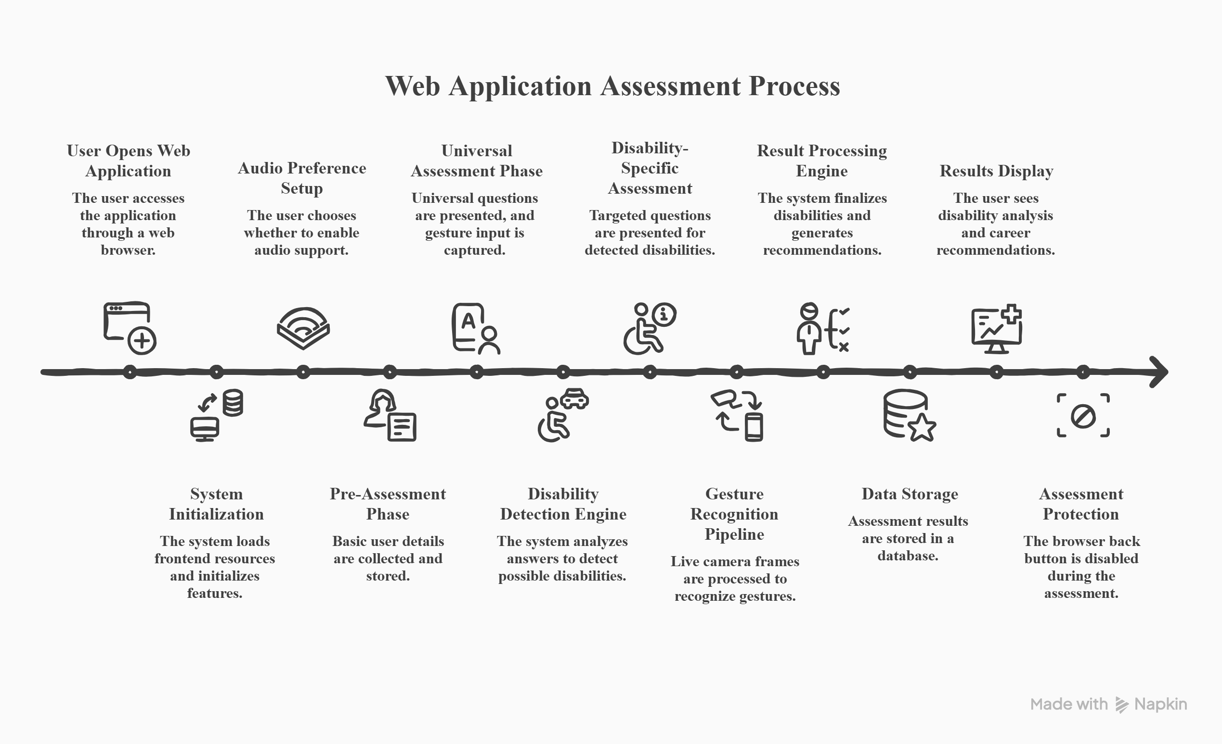
Flow Chart

Slide 12
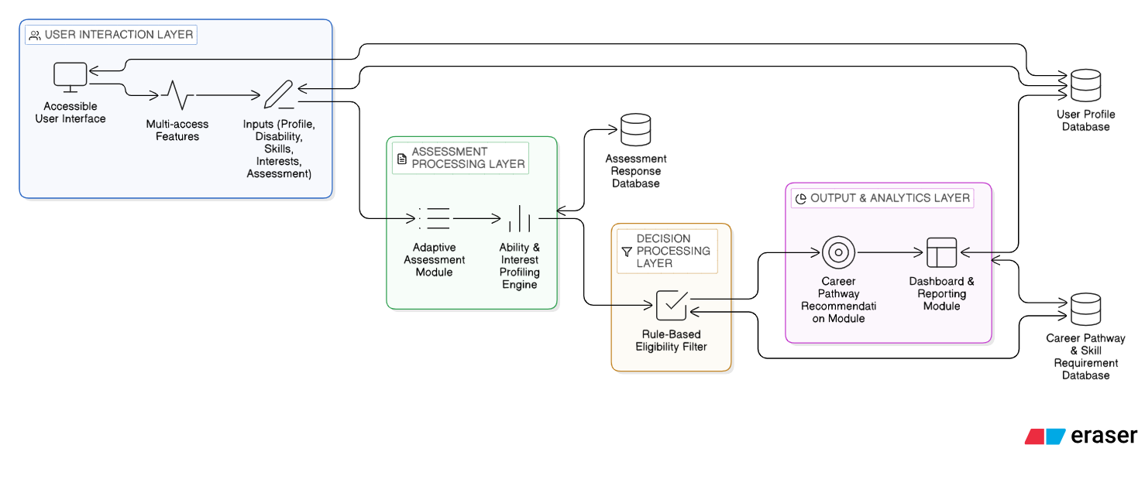
Proposed System Architecture

Slide 13
Difference from Existing Solutions
Provides disability-specific adaptive assessments, unlike generic interest-based systems
Implements hybrid Rule-Based recommendation framework instead of single-method approaches
Includes accessibility-aware career eligibility filtering before recommendation
Maintains structured disability-inclusive career and accessibility requirement database
Supports continuous recommendation updating based on user performance and feedback

Slide 14
Experimental Setup
Input / Dataset Details
Gesture recognition dataset with 5 gesture classes: YES, NO, REPEAT, SKIP, IDLE
~700 samples collected per gesture under different lighting conditions and hand orientations
Gesture features extracted using MediaPipe 21 hand landmark points (42 features)
Data preprocessing: landmark normalization, scaling, temporal smoothing (7-frame window)
Assessment workflow dataset includes user profile data, adaptive questionnaire responses, and capability scores
Performance Evaluation Parameters
Gesture recognition Accuracy, Precision, Recall
Detection latency (gesture prediction response time)
Audio triggering delay and audio continuity performance
System workflow completion time (assessment start to recommendation generation)
False positive detection rate
System crash rate and session stability
Accessibility compliance based on WCAG 2.1 Level AA

Slide 15
Hardware Setup
Processor: Intel i5 / Ryzen 5 (Quad-core minimum)
RAM: 8 GB or higher
Camera: 720p or higher webcam
Storage: 256 GB SSD
Operating System: Windows 10/11
Software / Technology Stack
Programming Language: Python 3.8+
Backend Framework: Flask REST API
ML Frameworks: TensorFlow / Keras
Computer Vision: OpenCV, MediaPipe
Database / Storage: Firebase
Frontend: HTML5, JavaScript (MediaDevices API, Web Speech API)
Deployment Setup
Backend hosted on local Flask server
Frontend browser-based accessible assessment interface
REST endpoint used for real-time gesture prediction and recommendation generation

Slide 16
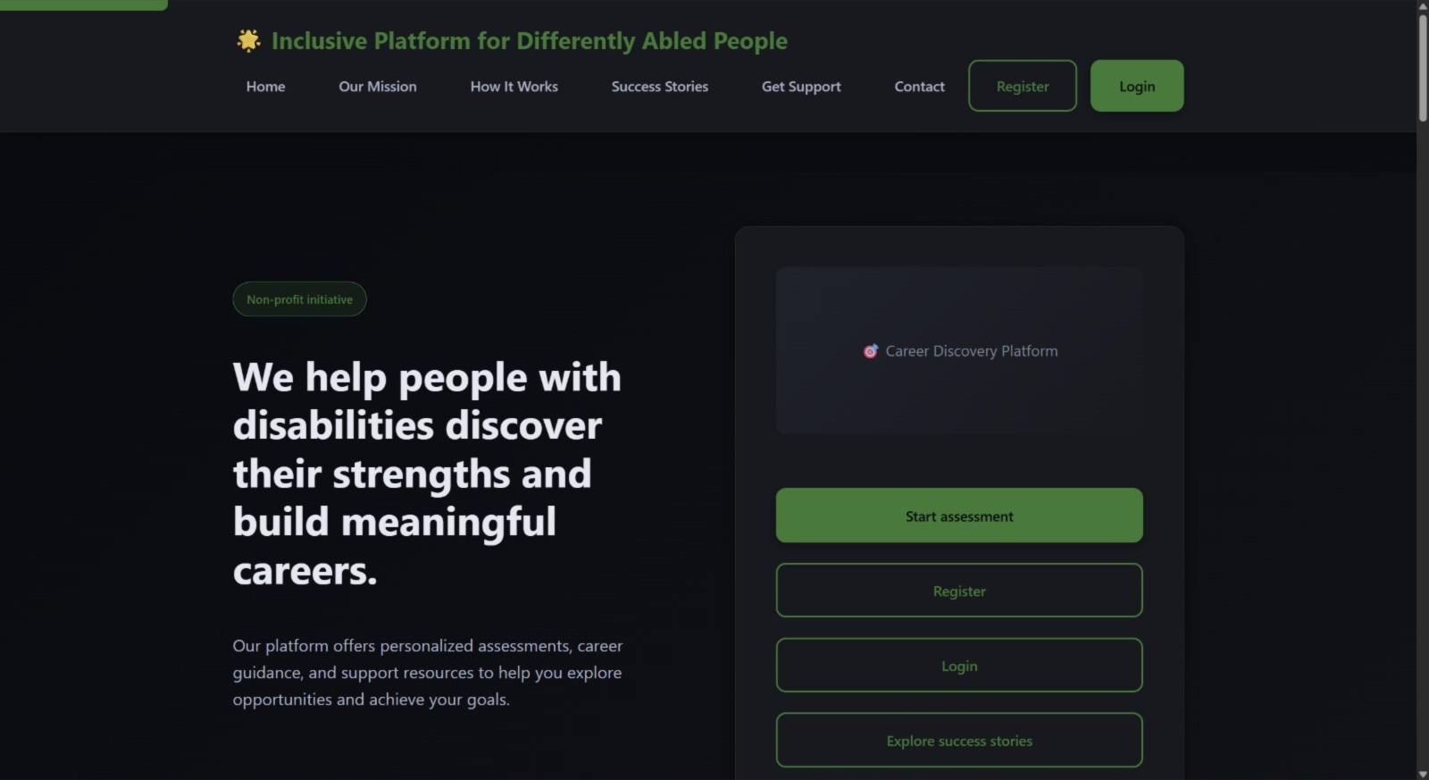
Implementation

Slide 17
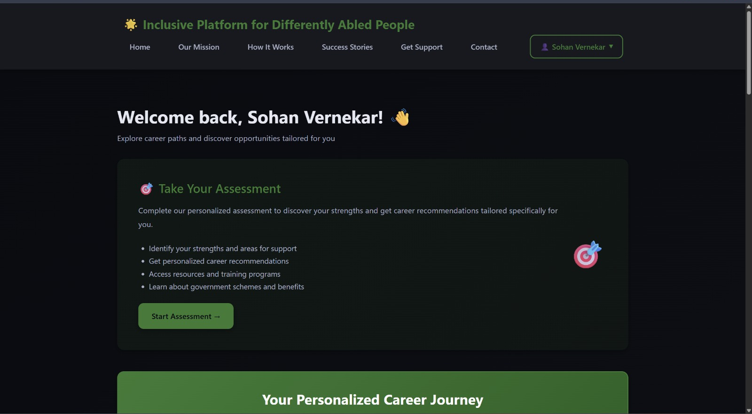

Slide 18
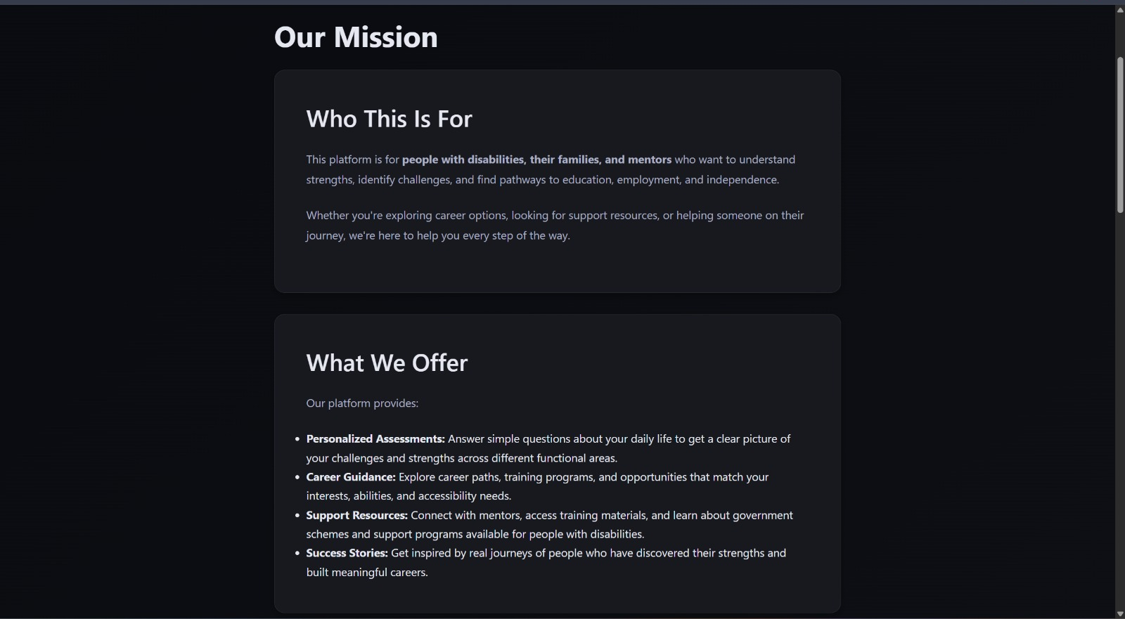

Slide 19
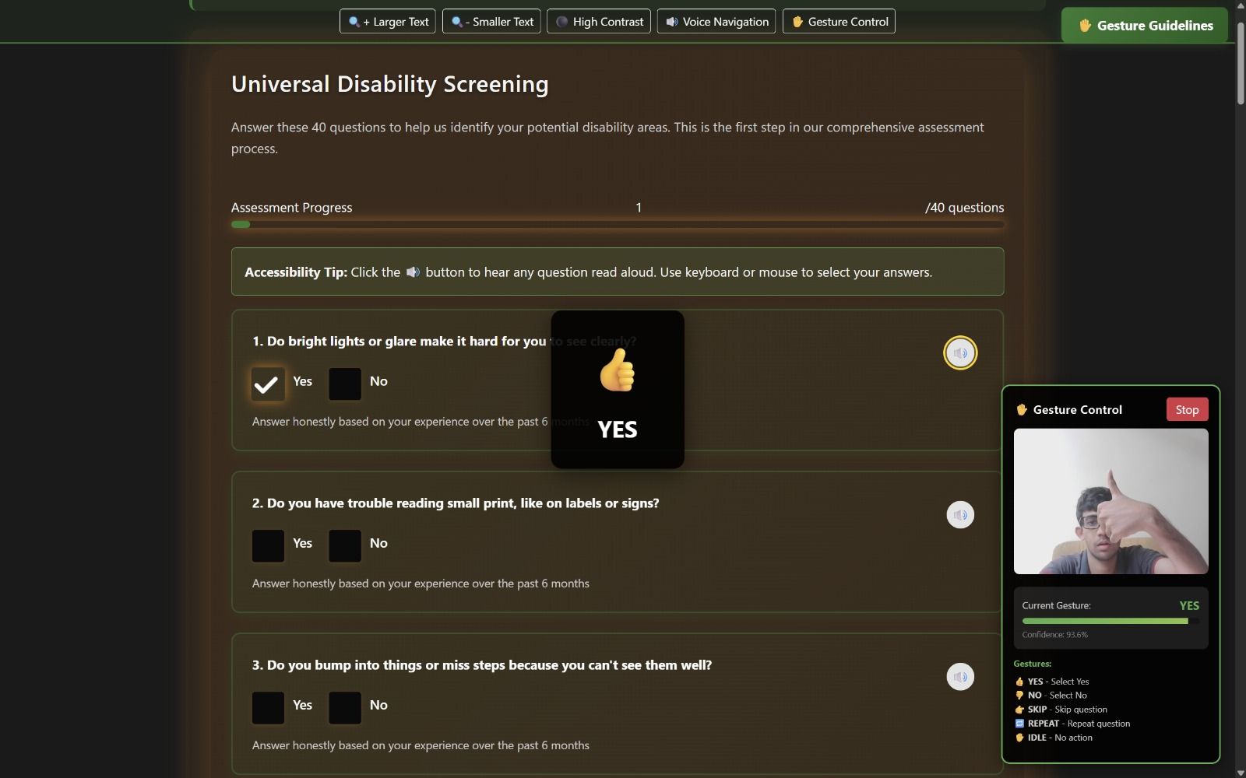

Slide 20
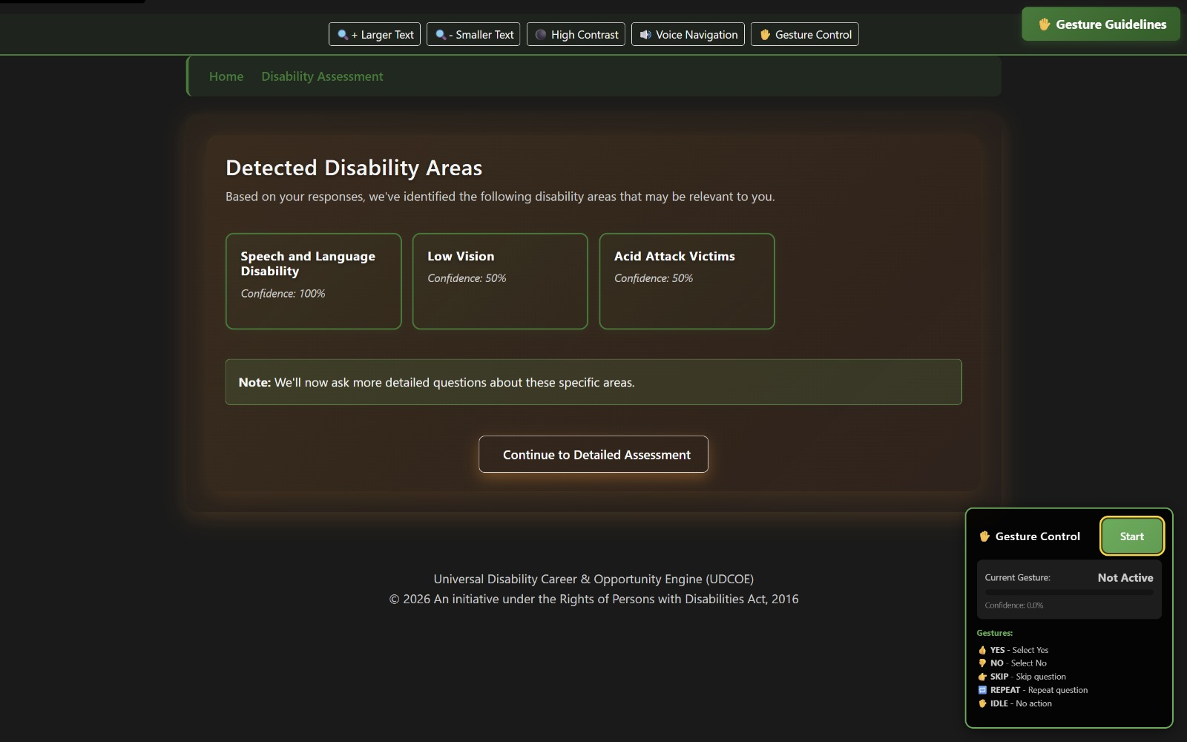

Slide 21
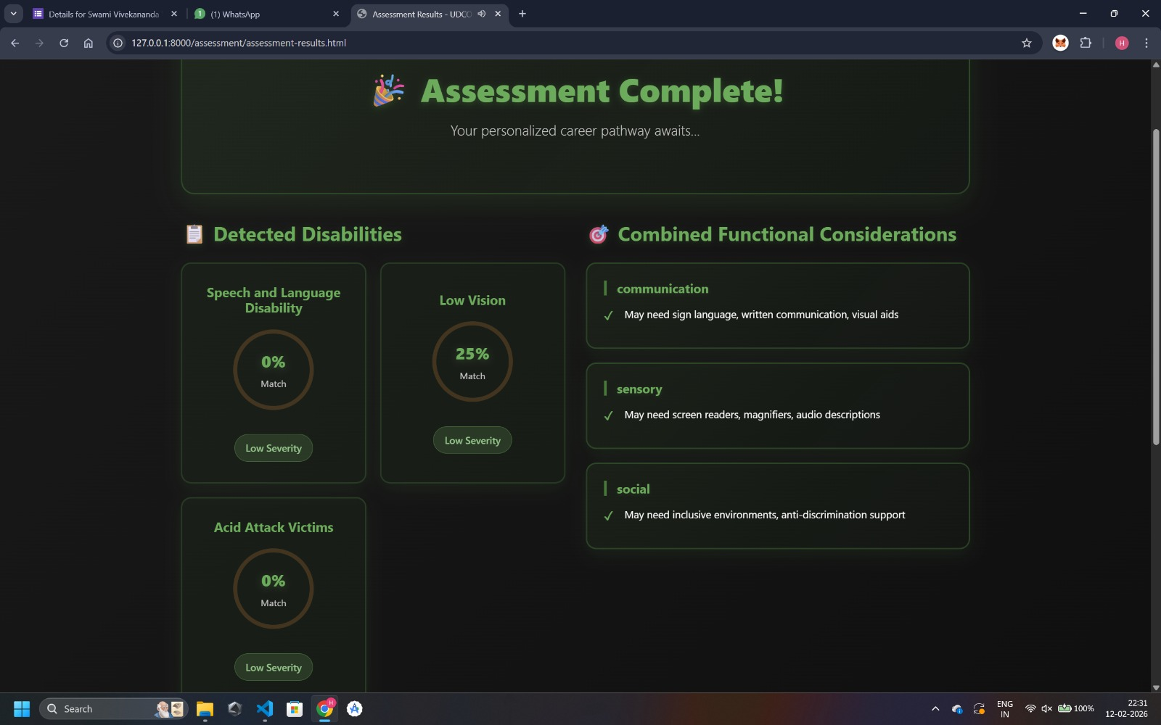

Slide 22
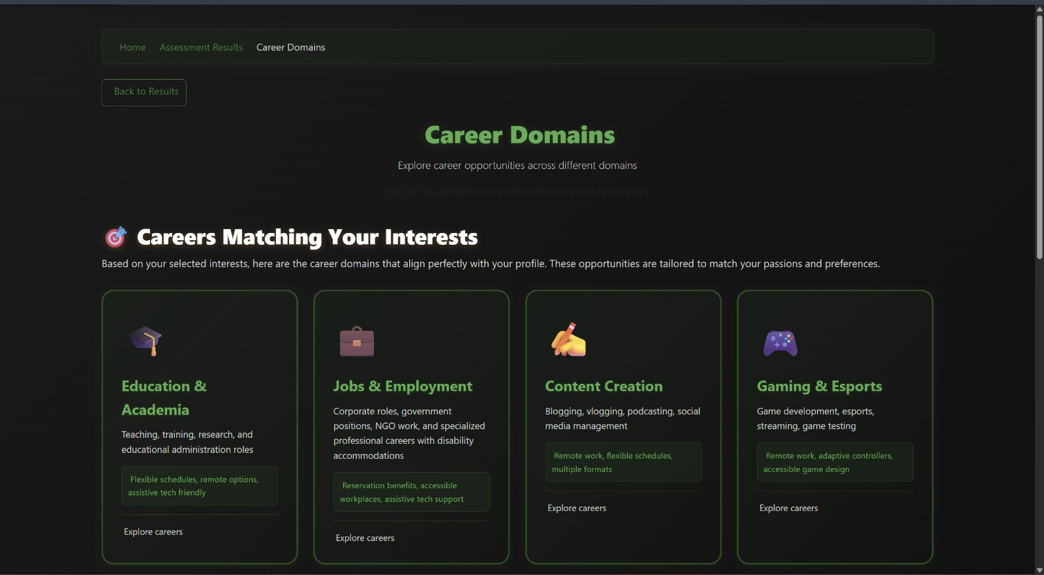

Slide 23
Result & Analysis
Performance Metrics
Gesture recognition model achieved ~90–93% accuracy
Average detection latency ~600 ms under real-time conditions
False trigger rate reduced using 3-frame stability and cooldown logic
System initialization optimized (60–99% faster) compared to baseline implementations
Continuous assessment workflow completed with 0% crash rate
Accessibility & System Functionality Results
100% continuous Text-to-Speech support across assessment flow
First assessment question audio playback < 5 seconds
Full interface verified for WCAG 2.1 accessibility compliance
Supports hands-free gesture-driven assessment navigation

Slide 24
Assessment & Recommendation Performance
Successfully processed 40 universal + disability-specific adaptive questions
Capability detection supports up to 5 disabilities (21 types mapped)
Generated personalized career pathways and government scheme recommendations
System validated for real-time accessible assessment environments
Feature | Existing Career Systems | Proposed UDCOE System
Disability-specific adaptive assessment | Limited / Not integrated | Fully integrated
Hands-free interaction | Not available | Gesture-based navigation
Accessibility compliance | Partial | WCAG 2.1 compliant
Real-time assessment workflow | Limited | End-to-end automated
Career + scheme recommendation | Separate platforms | Unified recommendation engine

Slide 25
Conclusion and Future work
Summary of Outcomes
Developed an adaptive, accessibility-aware career recommendation platform for differently-abled individuals
Successfully integrated gesture-based interaction, adaptive assessment, and personalized recommendation engine
Achieved high gesture recognition accuracy (~90%+) with real-time response performance
Ensured WCAG 2.1 compliant accessible interface supporting hands-free assessment navigation
Generated personalized career pathways and scheme recommendations based on capability profiling
Objectives Achieved
Designed disability-specific adaptive assessment framework
Implemented rule-based recommendation system
Created inclusive career opportunity and accessibility requirement database
Enabled secure, real-time assessment workflow with continuous audio guidance
Provided accessible dashboards for users and support organizations

Slide 26
Future Work / Scope of Improvement
Expand dataset to include more gesture classes and multilingual speech support
Add mobile application version for wider accessibility
Incorporate continuous learning models for dynamic recommendation improvement
Extend platform integration with government employment portals and training providers
Enhance AI-based personalized skill-development learning pathways

Slide 27
References
[1] Holland, J. L., (1997) “Vocational Choice Theory” - https://www.ebsco.com/research-starters/economics/hollands-theory-career-choice
[2] Ebenezer Babalola, Shatha Ghareeb, Jamila Mustafina, “Online Job Search Application with Automatic Recommendation and Notification System” - https://ieeexplore.ieee.org/document/10911892
[3] Bigham et al. (2016), “Accessibility-Focused Computing” - https://webinsight.cs.washington.edu/papers/dissertation/dissertation.pdf
[4] World Bank Disability Employment Report (2021) - https://documents1.worldbank.org/curated/en/909561611117067647/pdf/The-State-of-Economic-Inclusion-Report-2021-The-Potential-to-Scale.pdf
[5] International Labour Organization Disability Inclusion Report (2022)

Slide 28
Thank You...!!

